Slide 1
ADABOOST Regression

Slide 2
What is Adaptive Boosting ADABOOST?
AdaBoost Regression (also known as AdaBoost.R2) is a type of boosting algorithm used for regression tasks. It works similarly to AdaBoost for classification, but instead of focusing on misclassified examples, it tries to minimize errors in predicting continuous values.
The AdaBoost algorithm is a machine learning technique that combines multiple weak classifiers to create a strong classifier by adjusting the weights of training samples. It is widely used in various object detection applications to improve performance.
Ensemble method in machine learning re-assign weight to each instance higher weights for in correcting classified.
Reduce bias and variance.
No fixed depth for Decision Tree Adaboost takes only stumps.

Slide 3
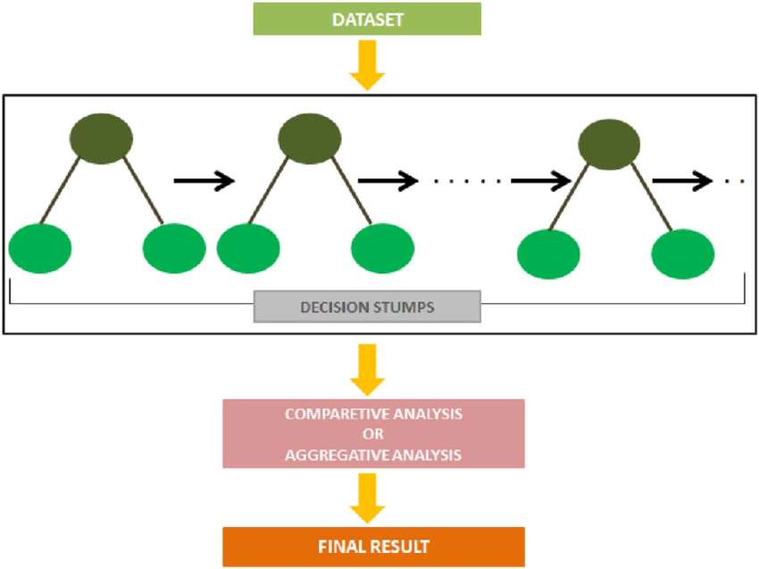

Slide 4
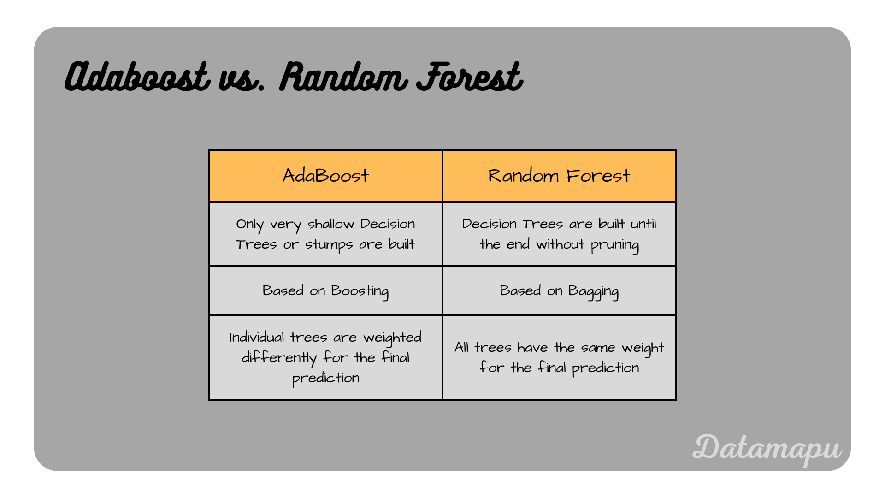

Slide 5
How AdaBoost Regression Works:
Step 01 - Initial weight assigned to each item = 1/n (No of records).
Step 02 - Iterate for each Week classifier.
a. Decision stump
- Train the Decision stump with a random bootstrap sample from the training dataset.
- Since there are only n data instances, use the full training dataset.
b. Compute the weighted error on current training dataset.
c. Compute the weight of each week classifier
Performance of stumps = 1/2loge((1 - Total Errors)/Total Errors)

Slide 6
d. Calculate the normalizing factor.
Normalizing factor = In correcting classified points + Correcting classified points
In correcting classified points of weight = weight x e power of performance say
Correcting classified points for weight = weight x e - power of performance say
e. Update the weight of all data instances:
(1/n*(e power of - Correcting classified points))/Normalizing factor
(1/n*(e power of In correcting classified points))/Normalizing factor
Step 03 - Compute the final predicted value for each data instance

Slide 7
Key Parameters:
Parameter | Meaning
base_estimator | The weak learner (default is Decision Tree Regressor).
n_estimators | Number of weak learners to combine.
learning_rate | Shrinks the contribution of each learner.
loss | Loss function used (e.g., 'linear', 'square', 'exponential').

Slide 8
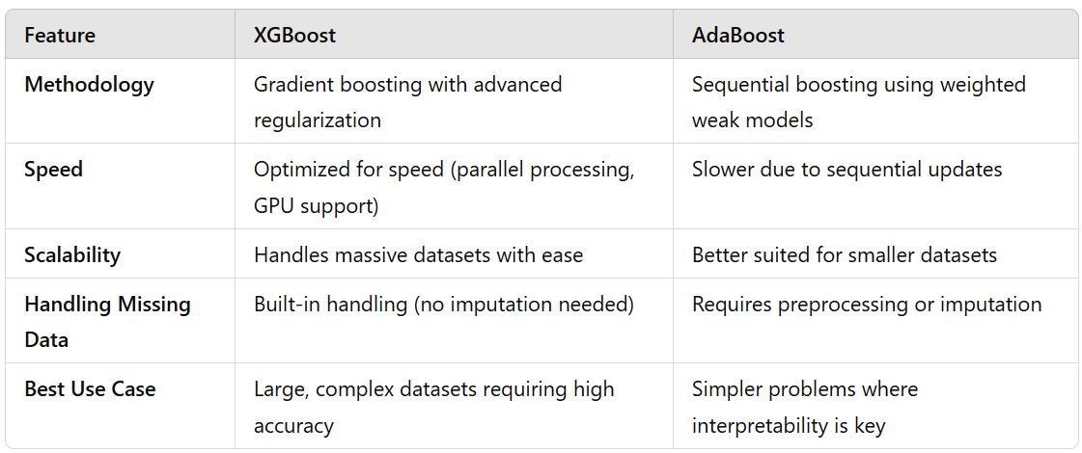
ADABOOST VS XGBOOST

Slide 9
